Slide 1
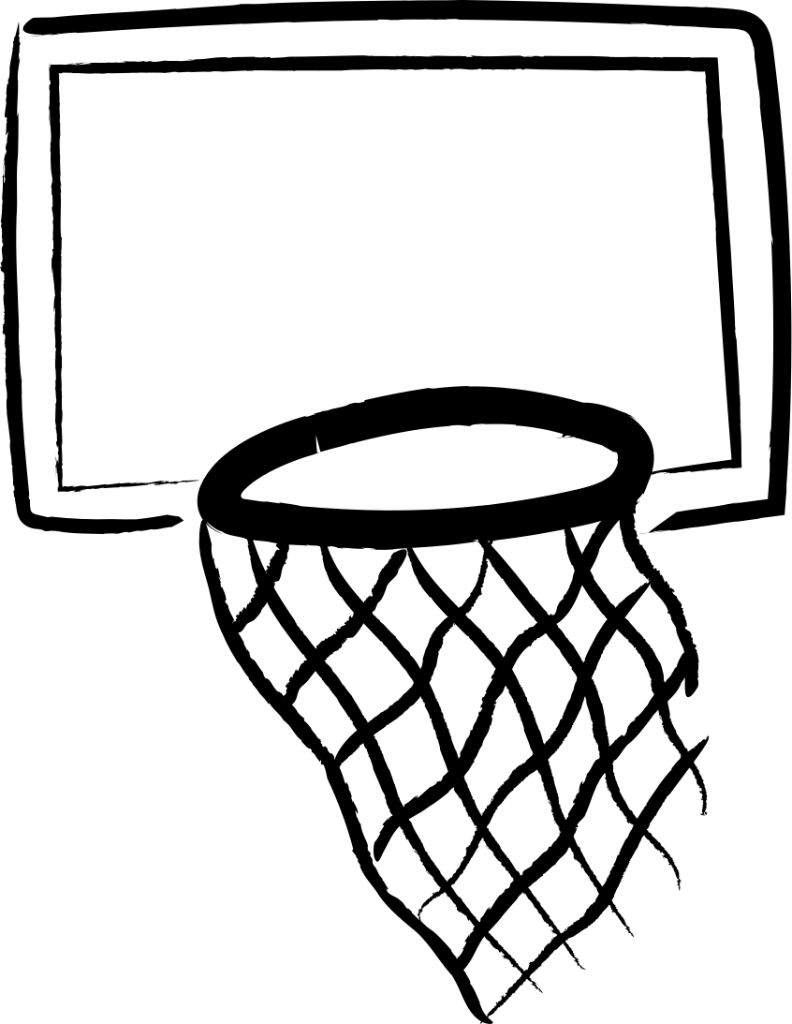
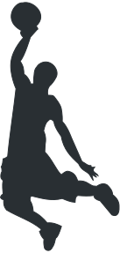
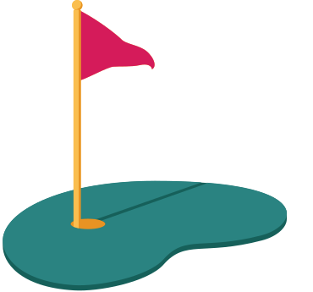

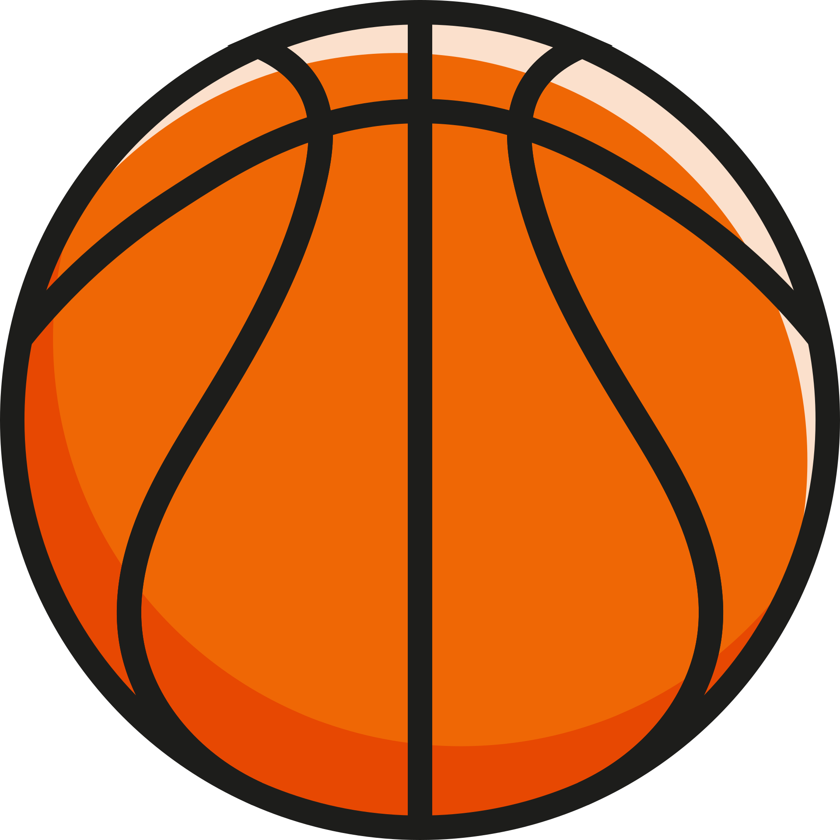
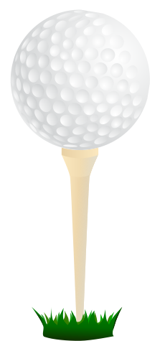
CFD AND EXPERIMENTAL ANALYSIS OF BASKETBALL AND GOLF BALL
GROUP 8

Slide 2
Objectives
To perform transient flow analysis around basketball and golf ball
To compare drag values for smooth ball and golf ball and justify the need for dimples
To analyze lift generation due to magnus effect in basketball

Slide 3
Literature Review
After the reviewing of some previous works on the same, we got familiar with the aerodynamics and what to expect from the simulations.

Slide 4
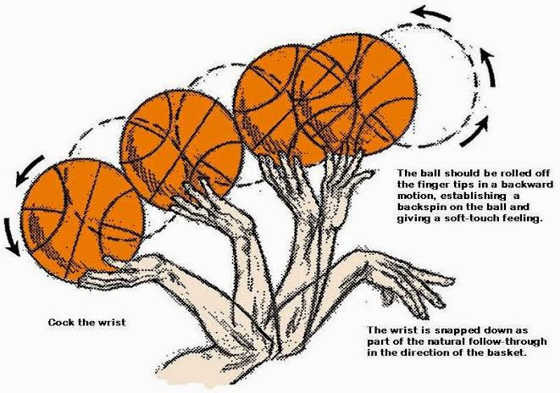
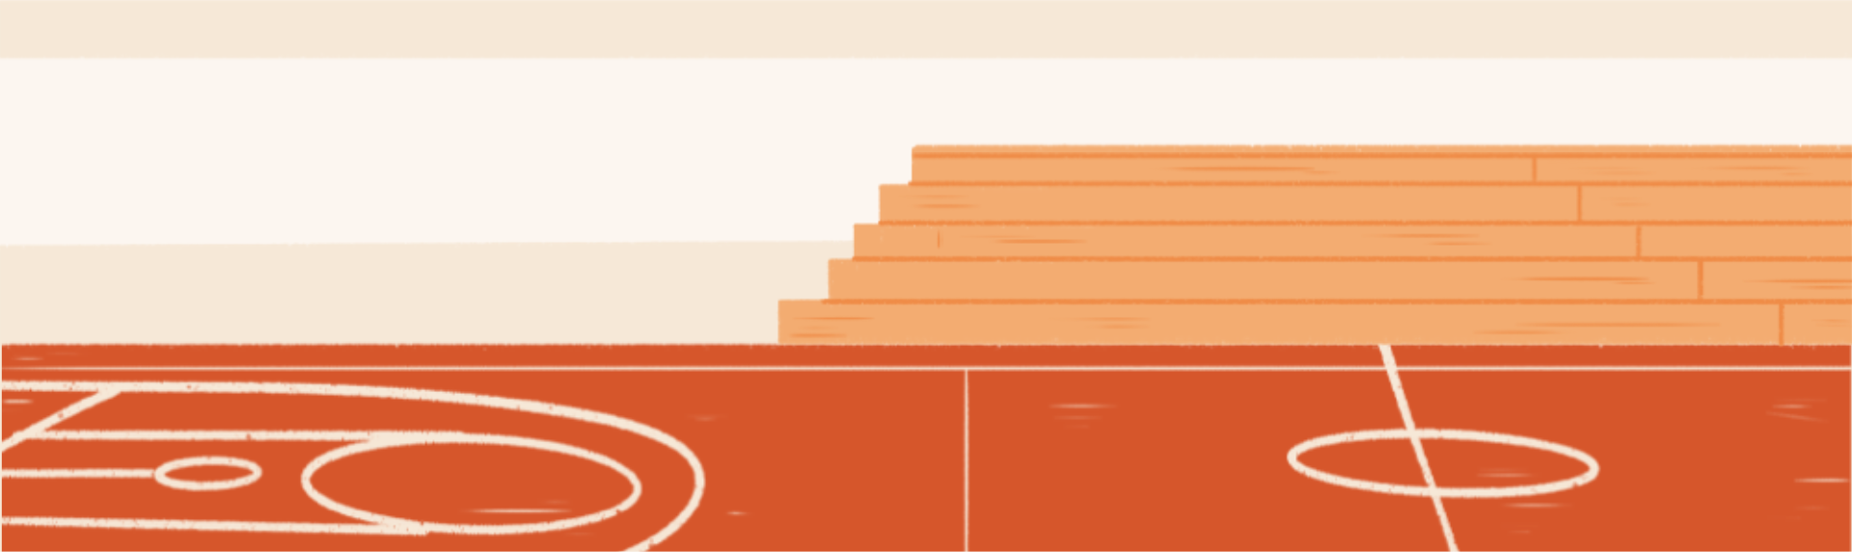
Magnus Effect on Basketball
There are four forces acting on a basketball in flight: gravity, buoyancy, magnus force and drag.
Backspin on a basketball is a technique used by players when shooting the ball, particularly for jump shots and free throws.

Slide 5
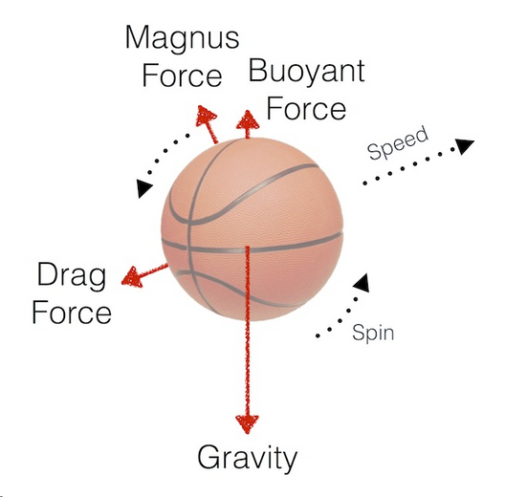
Magnus Effect on Basketball
Backspin affects the flight of the ball in the vertical direction by reducing the flow of air beneath the ball and increasing the flow of air above it. This difference in air speed creates a pressure differential (referred to as the Magnus Effect) that pushes the ball upward.
The Magnus effect allows the shooter to get the ball to the hoop with less translational speed, because the ball will “float” better than a ball without backspin.
This Magnus force increases as rotational speed increases and as translational speed increases.

Slide 6
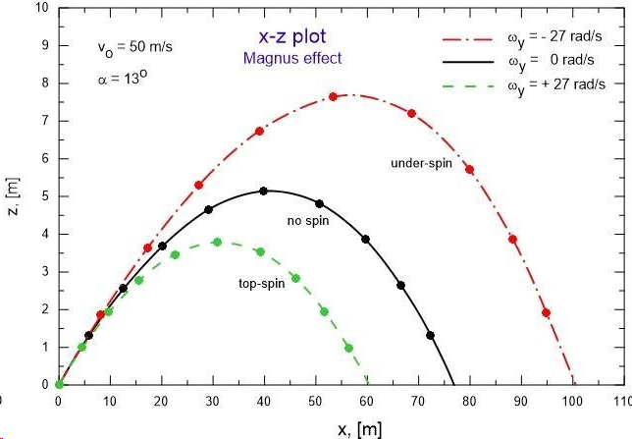

Slide 7
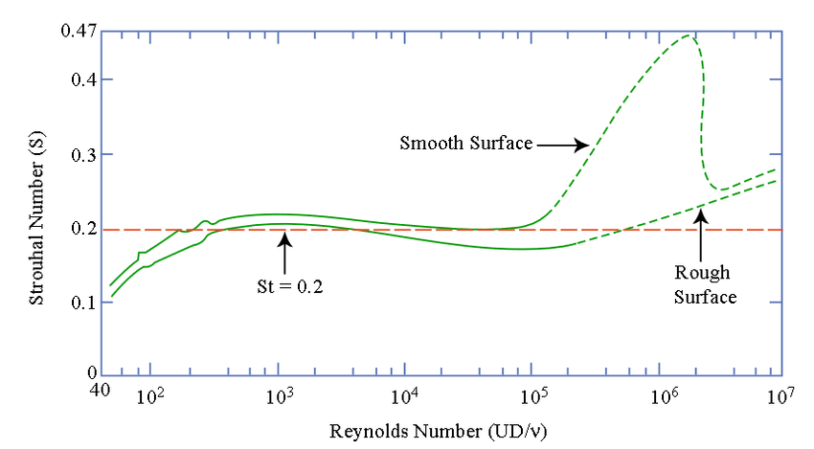
Timestep determination for transient analysis(basketball)
An estimate for the time step for simulation is determined based on the strouhal number for the flow around circular cylinders
Diameter of basketball = 0.52 m
Freestream velocity = 15 m/s
Reynolds number ~ 5 x 10e5
St = fD/V ~ 0.2
=> vortex shedding frequency
f ~ 5.7 Hz
Time period = 1/f ~ 0.18 s
20 timesteps per oscillation is recommended
=> timestep size = 0.18/20 ~ 0.01 s

Slide 8
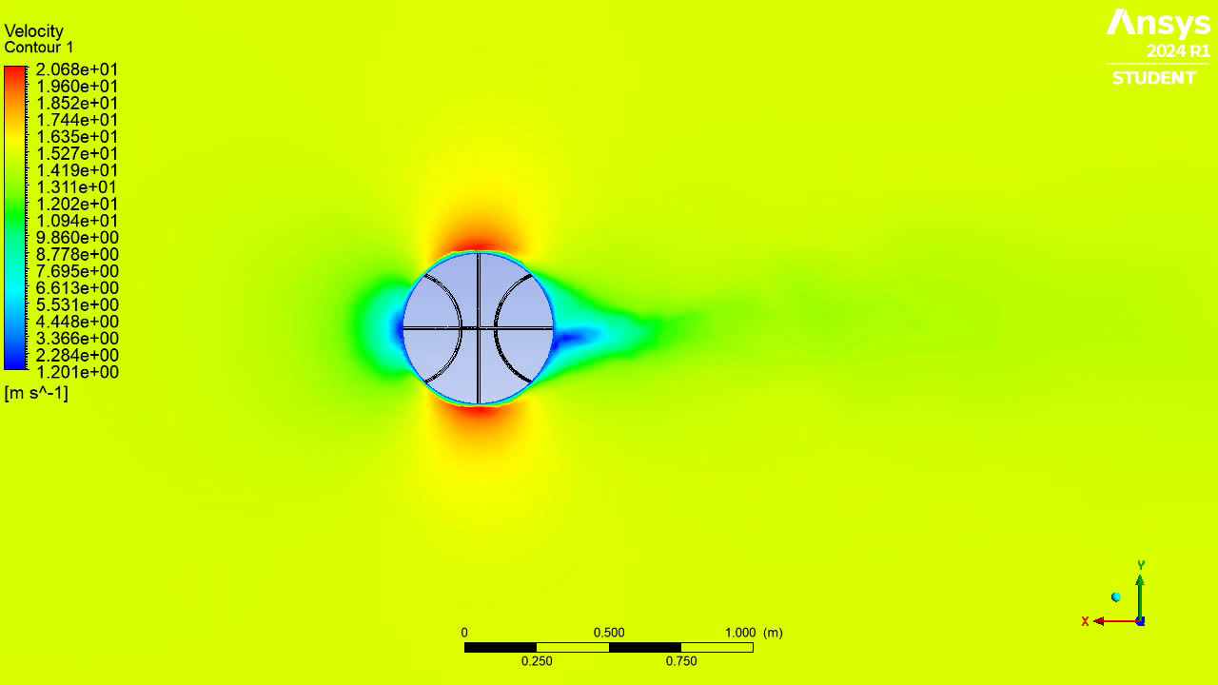
Velocity Contour - Basket ball with rotation (about)

Slide 9
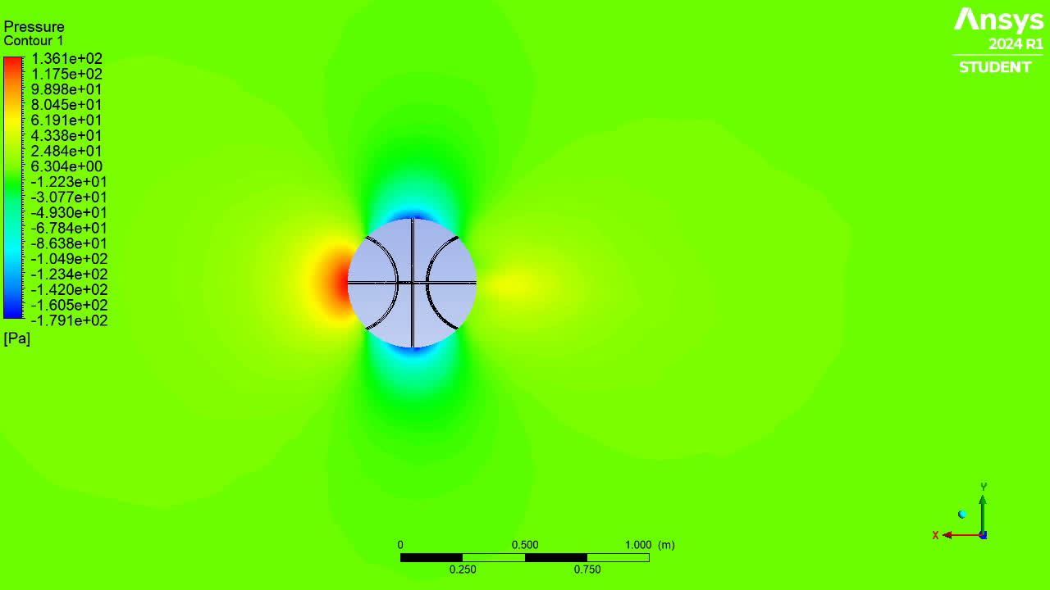
Pressure Contour - Basket ball with rotation (about)

Slide 10
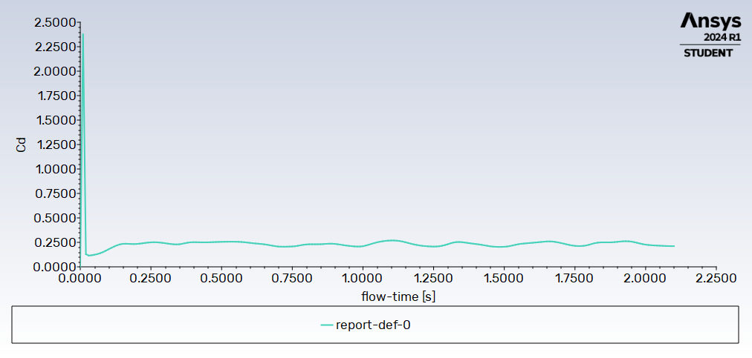
Cd plot - Basket ball with rotation (about)

Slide 11
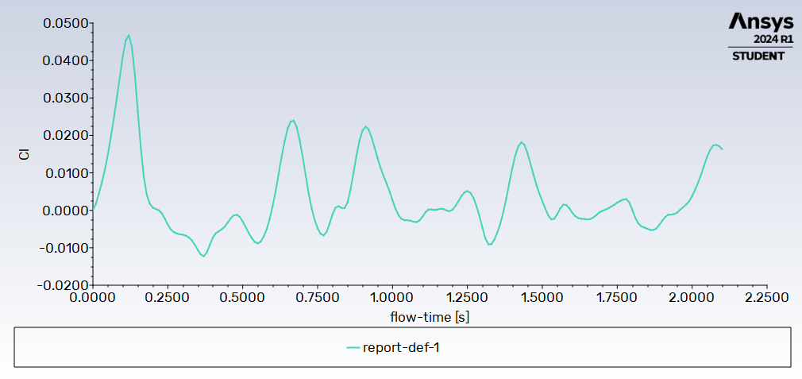
Cl plot - Basket ball with rotation (about)

Slide 12
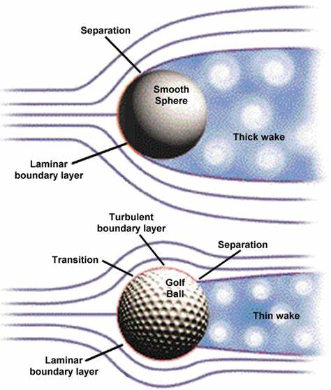

PURPOSE OF DIMPLES ON GOLF BALLS
The dimples in the golf ball serve to induce critical reynolds behaviour even at small reynolds numbers. Also unlike sand roughened golf balls the aerodynamic forces have lesser dependence on further increase in speed.
The number of dimples on the golf ball is usually between 330 and 500. Golf balls are usually covered with dimples in a highly symmetrical way. The ball will wobble if it’s not symmetrical, or its flight will depend on which part of the ball faces forwards or sideways as the ball spins.

Slide 13
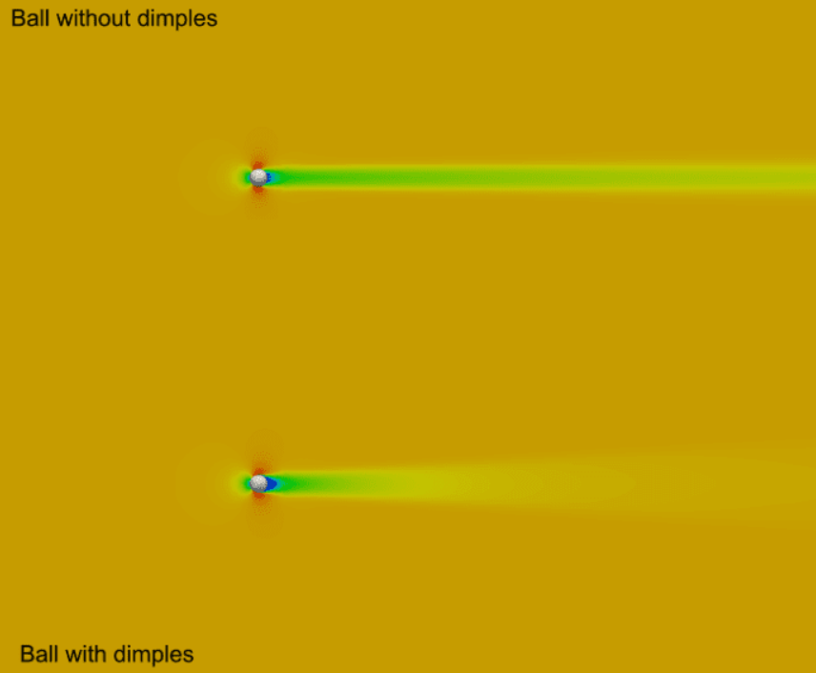
PURPOSE OF DIMPLES ON GOLF BALLS
The dimples act as artificial turbulators, creating turbulence next to the ball surface and creating two layers of air going around the ball. The top layer is going faster than the bottom layer, i.e., air clings to the ball’s surface, which creates turbulence. This reduces the drag and helps the ball to travel farther than a smooth one.

Slide 14
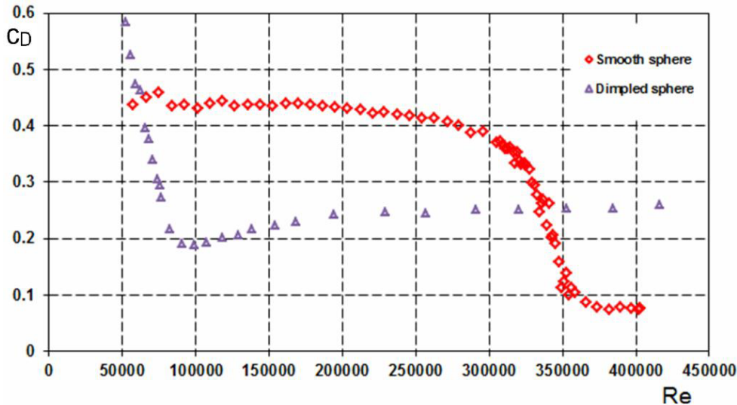
DIMPLES ON GOLF BALLS
We saw some differentiative data between smooth and dimpled golf ball in a paper (1), which aligned to our understanding of the aerodynamics around a dimpled golf ball.
We can notice that there is a significantly larger drag for smooth ball as compared to the dimpled one for a considerable range of Reynold’s number, except for very high Reynold’s numbers past 340000.

Slide 15
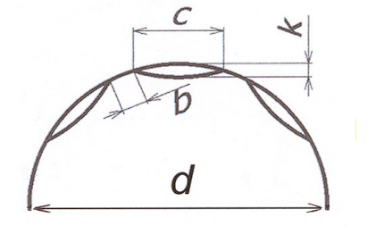
EFFECT OF DIMPLE DIAMETER AND DEPTH
The independent effect of dimple size and depth of a golf ball has been studied by Ting[3] using CFD analysis. Using a golf ball surface design with 344 identical dimples, but keeping the dimple distribution pattern and the dimple diameter unchanged, the dimple depth effect was first investigated by varying the dimple depressions
d - diameter of the ball
c - dimple diameter
k - dimple depth
b - distance between two dimples

Slide 16
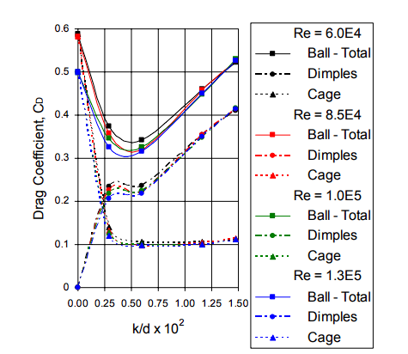
The drag coefficient CD of the golf ball is plotted as a function of k/d for the Reynolds numbers equal to 6.0e4 , 8.5e4 , 1.0e5 , and 1.3e5.
A minimum Cd value of about 0.325 on average is reached within the range of k/d between 0.0045 to 0.0055
Beyond upper limit of k/d = 0.0055, Cd increases sharply as k/d increases
Cage contribution to drag : Significant till k/d = 0.004. Cage Cd becomes constant of about 0.1 beyond k/d = 0.004.
Dimple contribution : Cd increases with dimple depth until k/d ~ 0.0026. A constant Cd zone is then seen to be followed. Beyond the value of 0.006, Cd increases again.
d = 43.612 mm
c = 3.785 mm

Slide 17
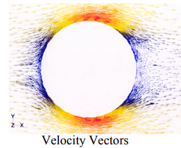
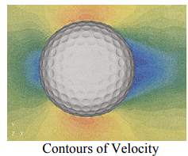
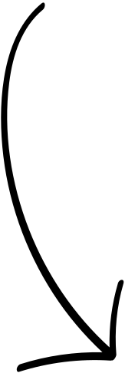
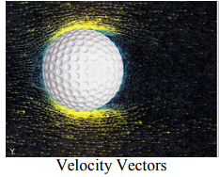
Wake region decreases => Cd decrease
k = 0.127 mm
k = 0.262 mm (near optimum)
k = 0.645 mm
Wake region increases => Cd increase

Slide 18
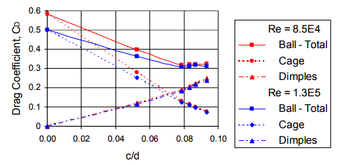
The dimple size effect was investigated with dimple size diameter varying from small to large keeping the other parameters constant
d = 43.612 mm
k = 0.262 mm
k/d = 0.00599
(near optimum)
As c/d starts to increase the drag coefficient is seen to decrease.
Cd approximately becomes a constant of about 0.3 beginning at c/d = 0.08.
Cage contribution : Cage area Cd decreases steadily as c/d increases
Dimple contribution : Dimple area Cd increase as c/d increases

Slide 19
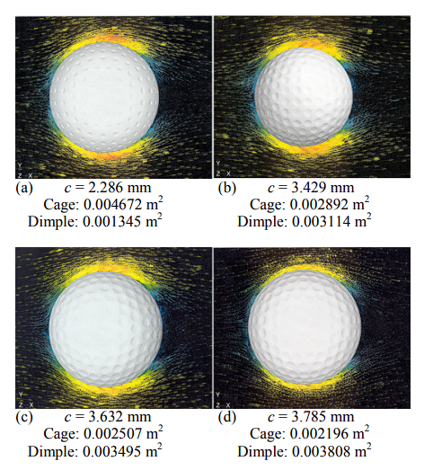
The wake region reduces as the dimple diameter increases resulting in the decrease of Cd

Slide 20
Timestep determination for transient analysis(golf ball)
Diameter of basketball = 0.042 m
Freestream velocity = 60 m/s
Reynolds number ~ 1.6 x 10e5
St = fD/V ~ 0.18
=> vortex shedding frequency
f ~ 250 Hz
Time period = 1/f ~ 0.004 s
20 timesteps per oscillation is recommended
=> timestep size = 0.004/20 ~ 0.0002 s , which is of the order 1e-4
So timestep size is taken as 0.0001 s

Slide 21
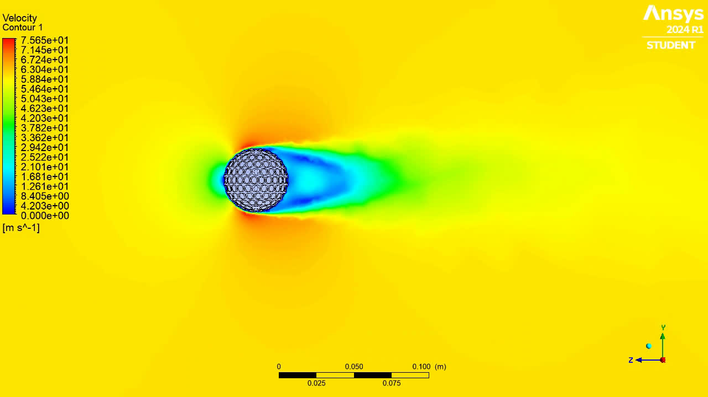
Velocity Contour - Golf Ball (with dimples)

Slide 22
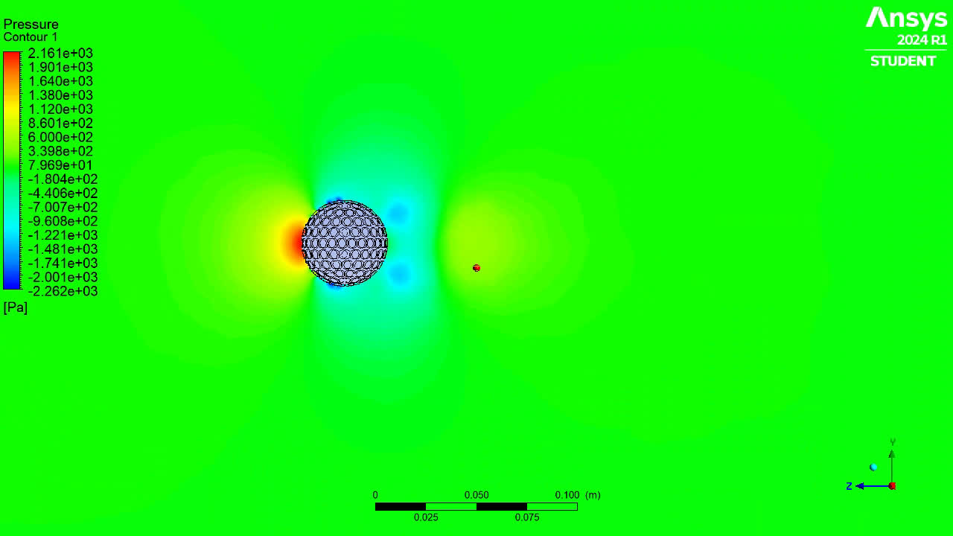
Pressure Contour - Golf Ball (with dimples)

Slide 23
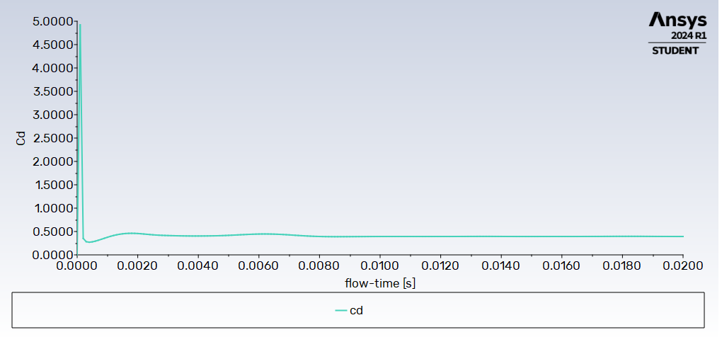
Cd plot - Golf Ball (with dimples)

Slide 24
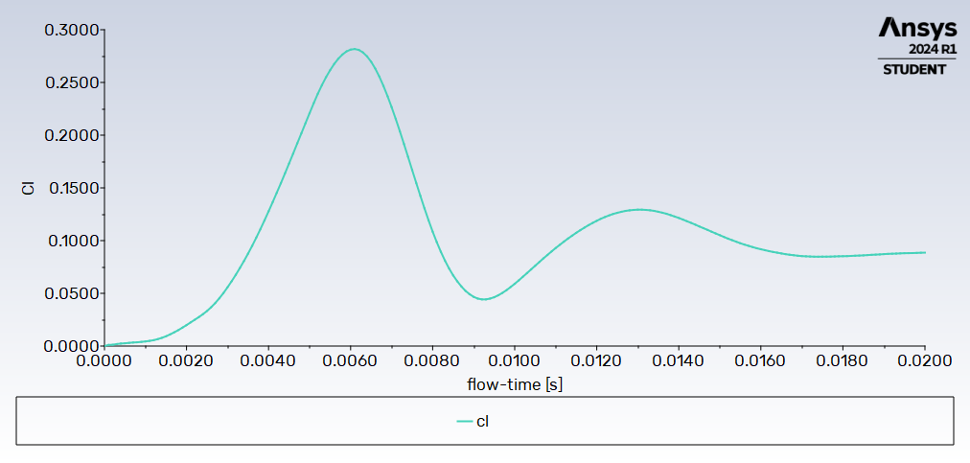
Cl plot - Golf Ball (with dimples)

Slide 25
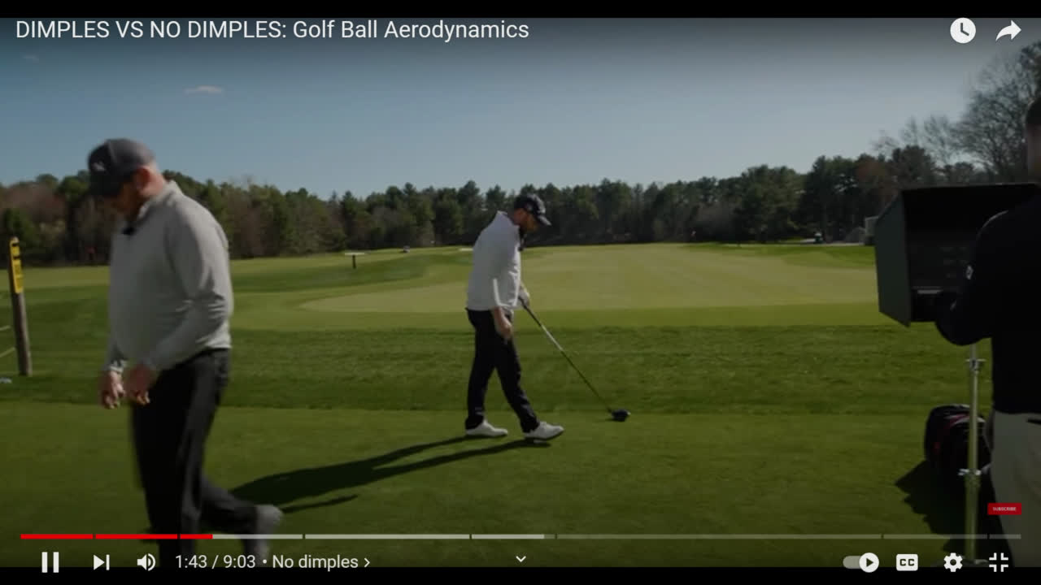
Experiment with Golf Balls
Hitting a golf ball without dimples

Slide 26
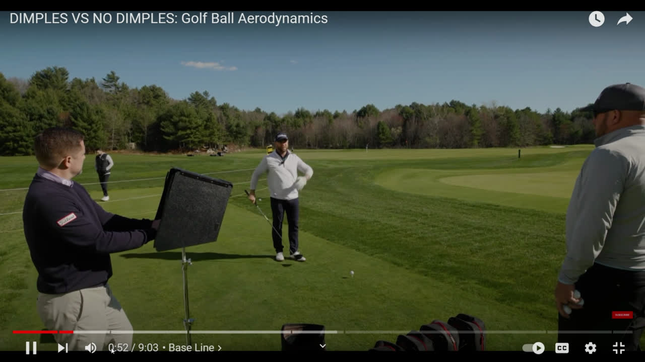
Golf ball with dimples hit in a similar manner

Slide 27
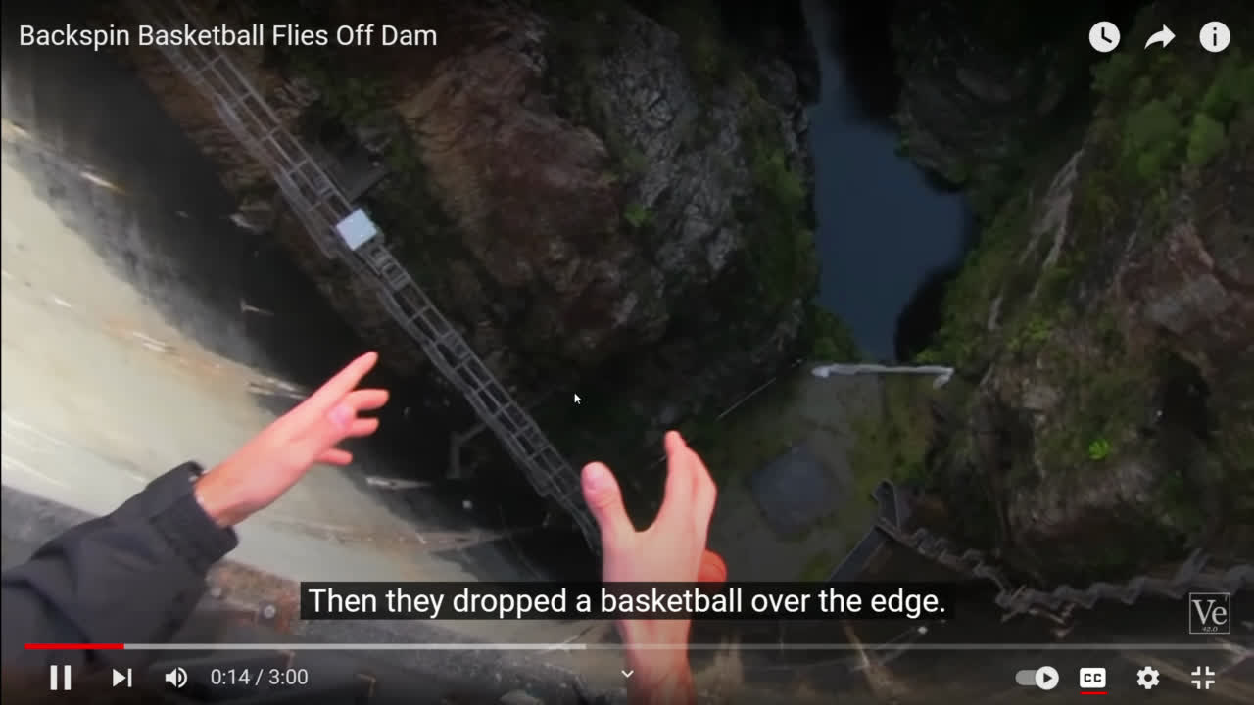
Dropping a Basketball off a dam with and without spin

Slide 28
References
1) CFD simulation of dimpled sphere and its wind tunnel verification - Vojtěch Spálenský1,* and Dalibor Rozehnal1
2) How Dimples on a Golf Ball Affect Its Flight and Aerodynamics - Sam Prabhu Jesu Rajendran
3) Ting, L. L. "Effects of dimple size and depth on golf ball aerodynamic performance." Fluids Engineering Division Summer Meeting. Vol. 36975. 2003
4) Fontanella, John J. The physics of basketball. JHU Press, 2006
5) Penner, A. Raymond. "The physics of golf." Reports on progress in Physics 66.2 (2002): 131.
6) Bearman, Peter W., and John K. Harvey. "Golf ball aerodynamics." Aeronautical Quarterly 27.2 (1976): 112-122.
7) Ting, L. L. "Application of CFD technology analyzing the three-dimensional aerodynamic behavior of dimpled golf balls." ASME international mechanical engineering congress and exposition. Vol. 36576. 2002.
8) Goff, John Eric. "A review of recent research into aerodynamics of sport projectiles." Sports engineering 16.3 (2013): 137-154.

Slide 29
Group Members
Aswin D Menon - 21AE10044
Rahul Sunil - 21AE10050
Adithyan U S - 21AE10049
Anfal S - 21AE10003
Sagar K P - 21AE30021
Allwin Johnjo Prince - 21AE10002
Arjun Biju - 21AE10007
Nikhith Mathai Manoj - 21AE10027
Jasothan V - 21AE30008

